Slide 1

Graph Data Structure
Team Members: Amanda Alves, Andre Haffner, Grecia Garcia, Samiksha Mallaiya and Wesley Chinda.

Slide 2
Group Project
Create a graph data structure (undirected graph) in Python with the following methods:
Print Vertices: Display all the graph’s vértices;
Print Edges: Display all the graph’s edges;
Add a vertex: Add a new vertex to the graph and connect it with all other vértices;
Delete a vertex: Delete a vertex from the graph.

Slide 3
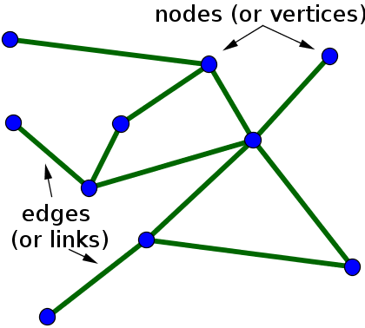
What Is a Graph?
Example of undirected graph:
Definition of a Graph:
“Set of vertices connected pairwise by edges.”
Definition of a undirected Graph:
“Any shape that has 2 or more vertices/nodes connected together with a line/edge/path is called an undirected graph.”
Undirected graph with 10 or 11 edges

Slide 4
What Is a Graph?
Vertices are the result of two or more lines intersecting at a point. Edges or Links are the lines that intersect.
Implementation of undirected graphs:
For example – Google map uses some of the graph algorithms to find the shortest distance between two points on Google Maps.
Many businesses today such as Ola, Uber… relies on the accuracy of these maps. Their entire business model revolves around it. Smallest miscalculation would cause them thousands of bucks. All of this is made possible just with the help of Graph Algorithms.
The first step is to transform a map into a graph. For these all-street intersections are considered as vertices and the streets that connect intersections as edges. The edges can have weights that represent either the physical distance between vertices, or the time that takes to travel between them. This graph can be directed showing also the one-way streets in the city.

Slide 5
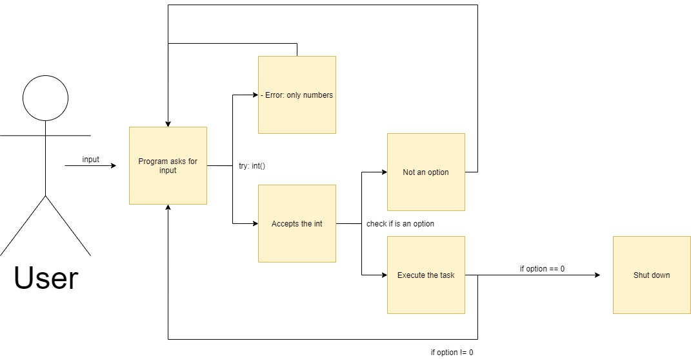

Slide 6
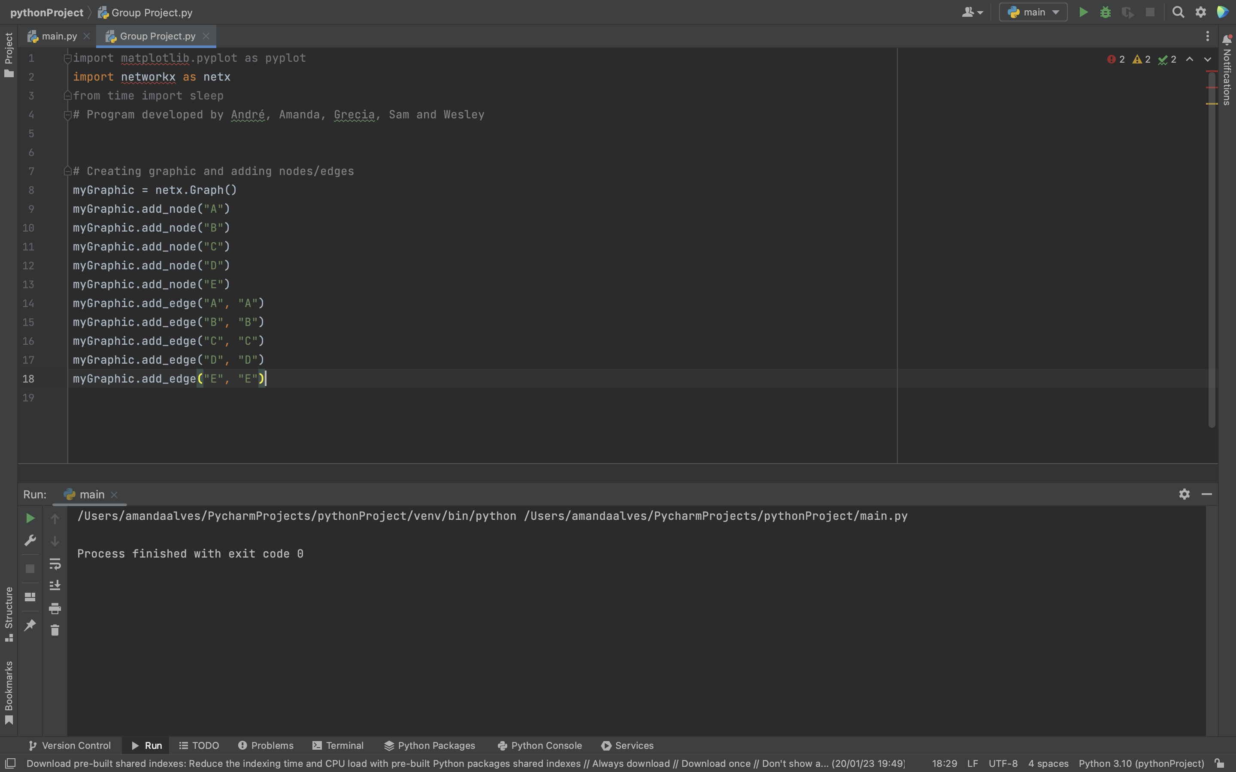
Starting to coding

Slide 7
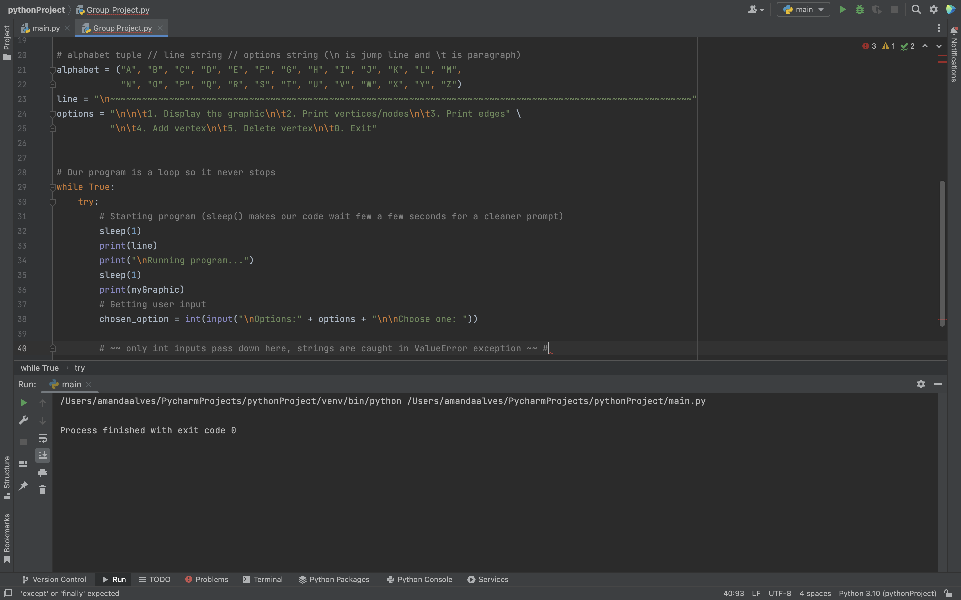
Starting to coding

Slide 8
Starting to coding
Display all the graph’s vertices

Slide 9
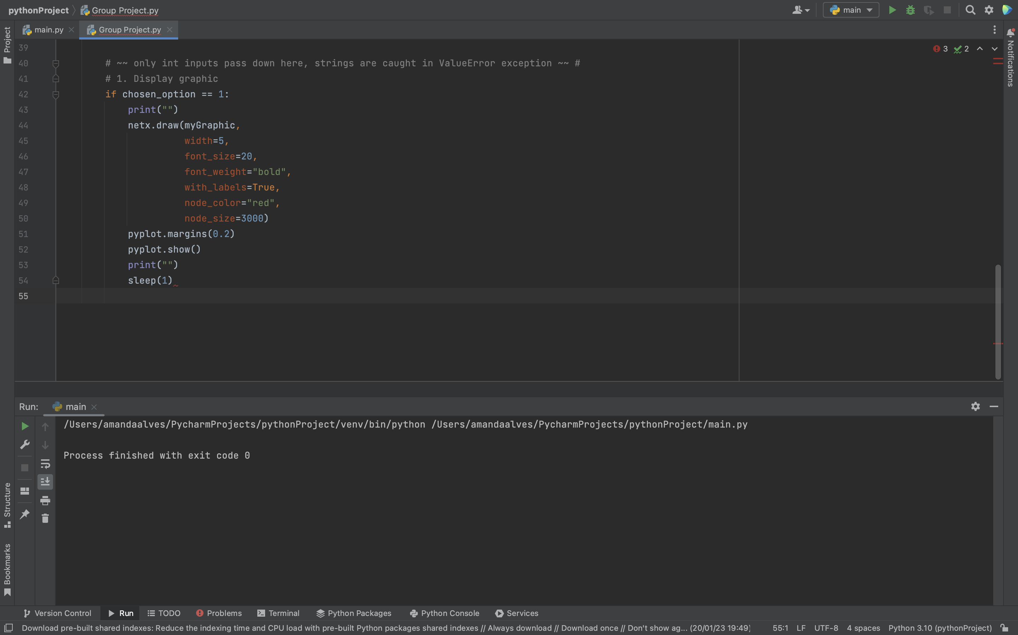
Display Graphic

Slide 10
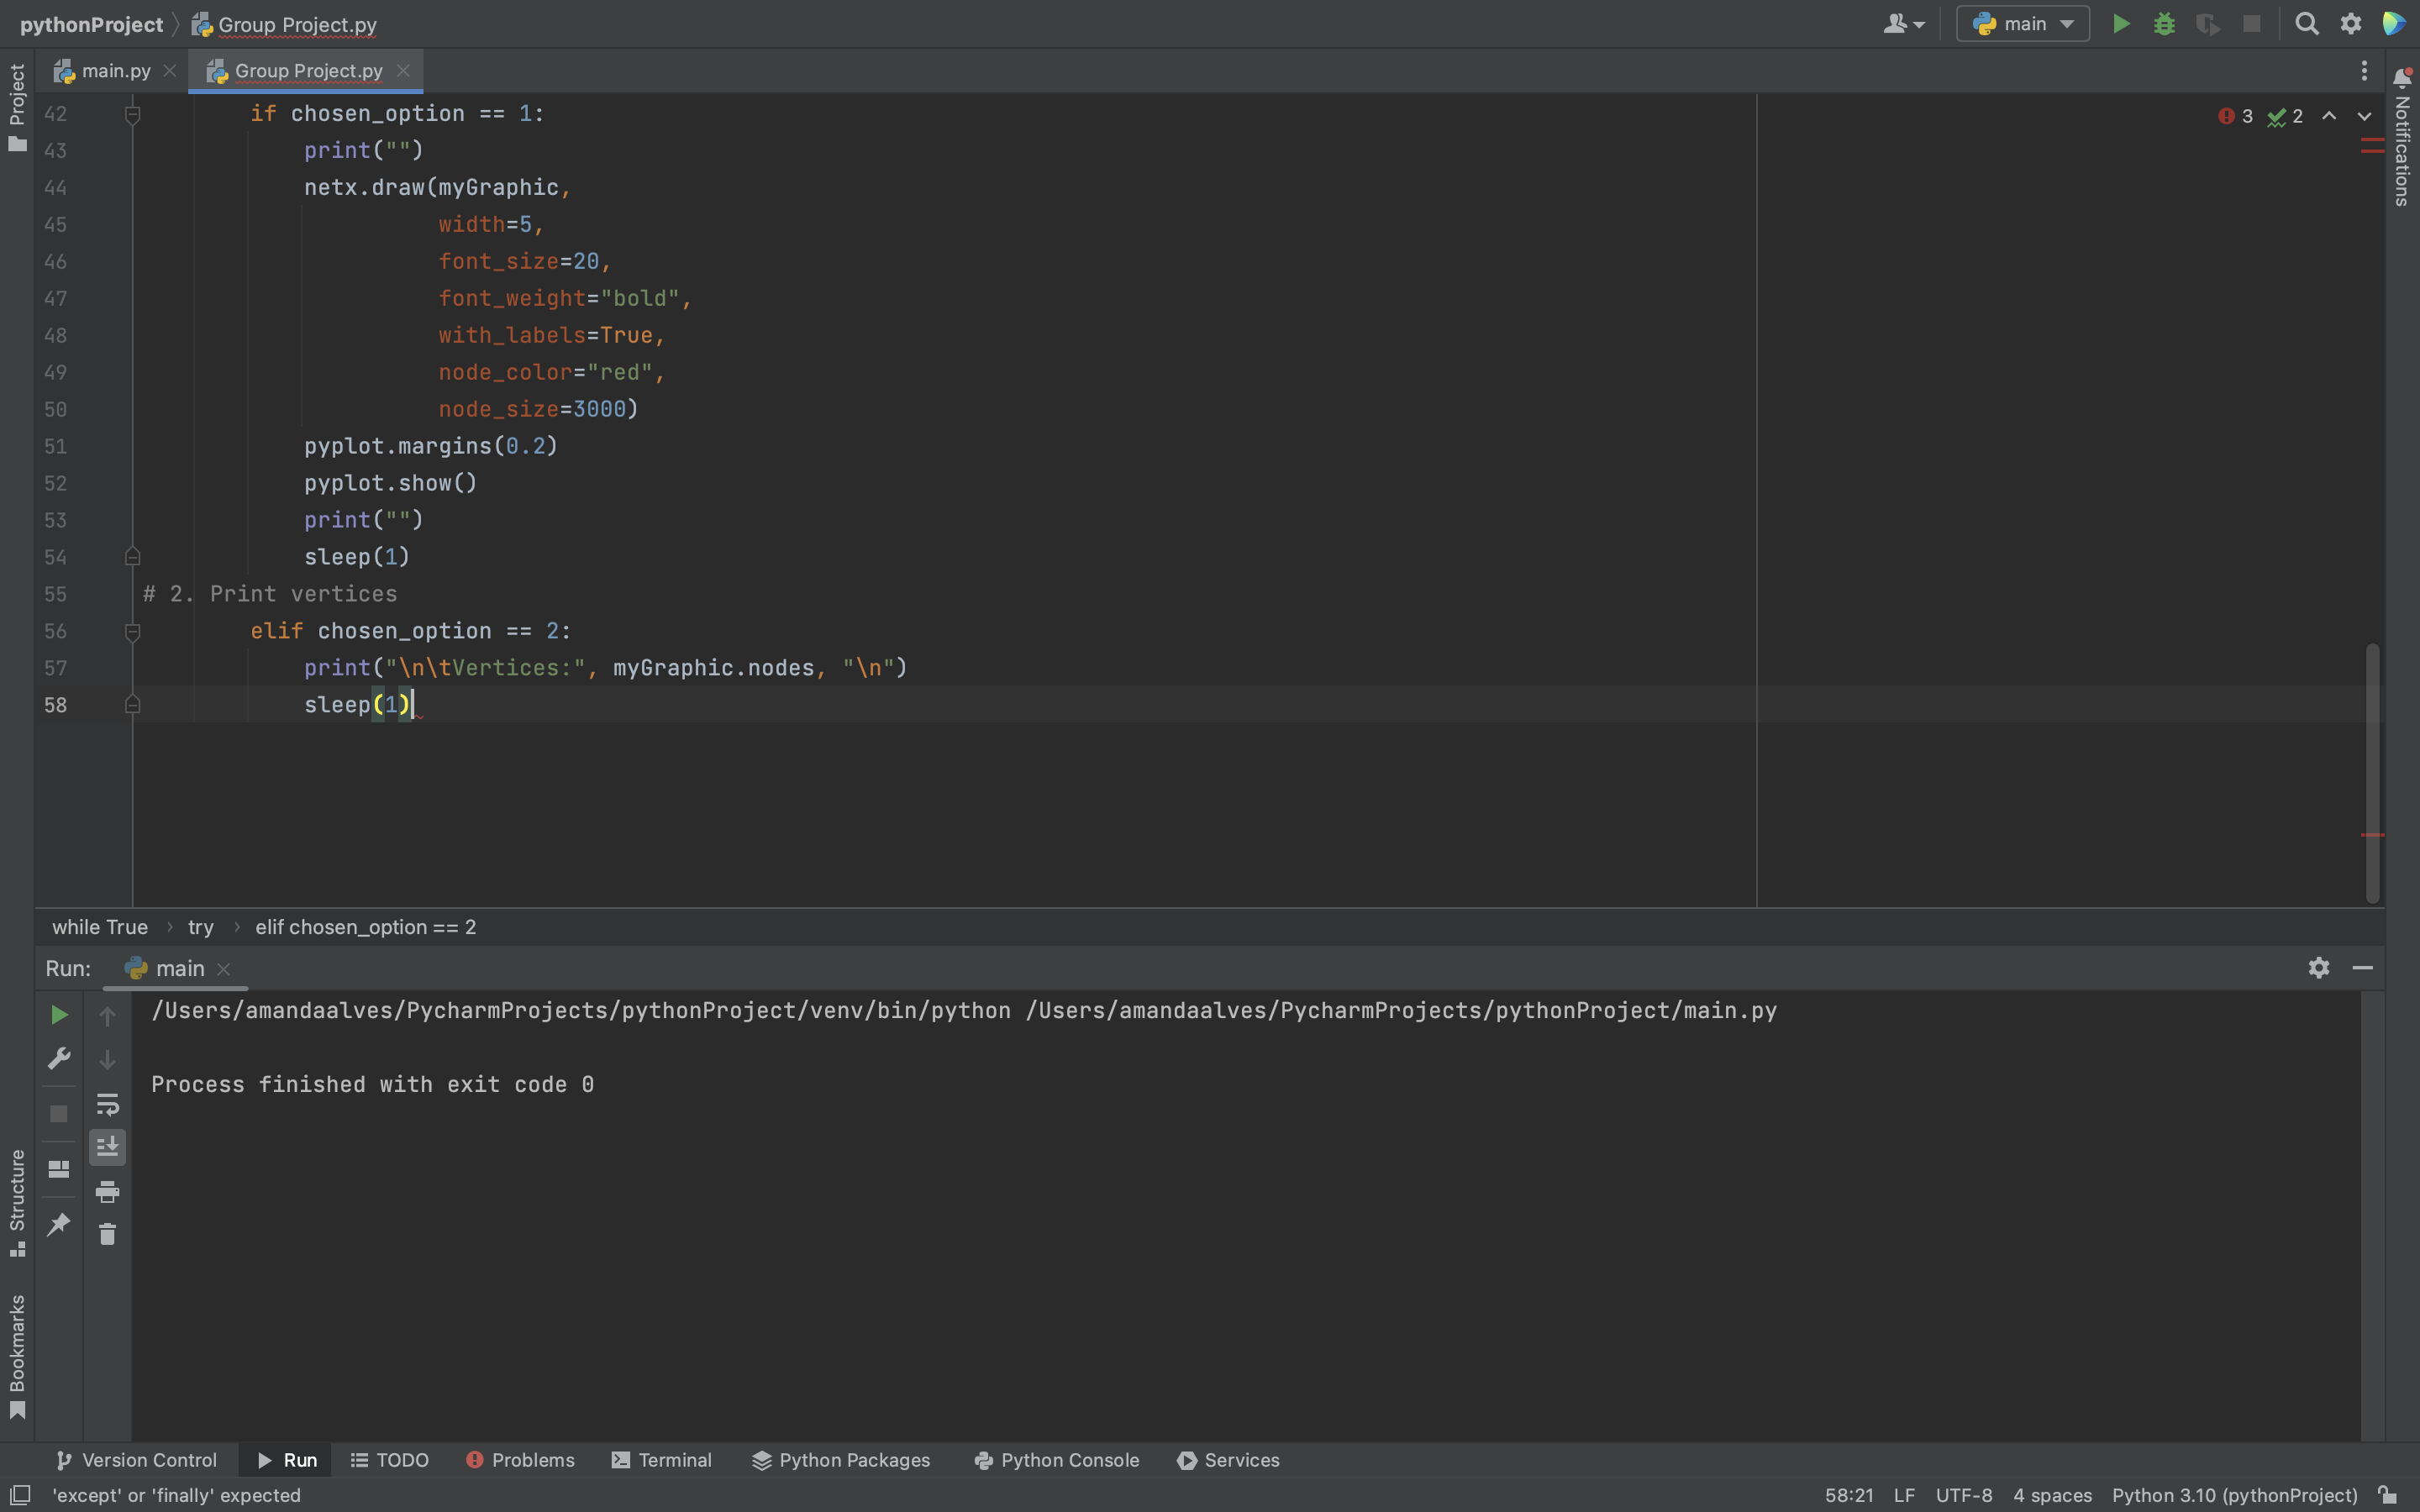
Print Vertices
Display all the graph’s vértices.

Slide 11
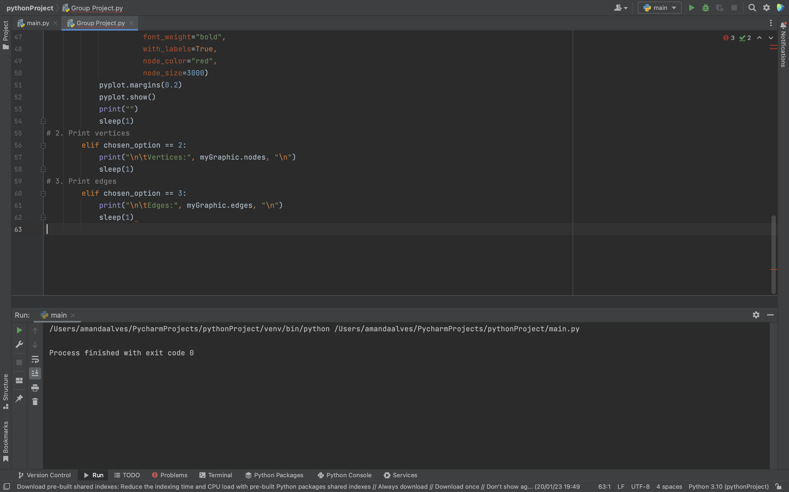
Print Edges
Display all the graph’s edges.

Slide 12
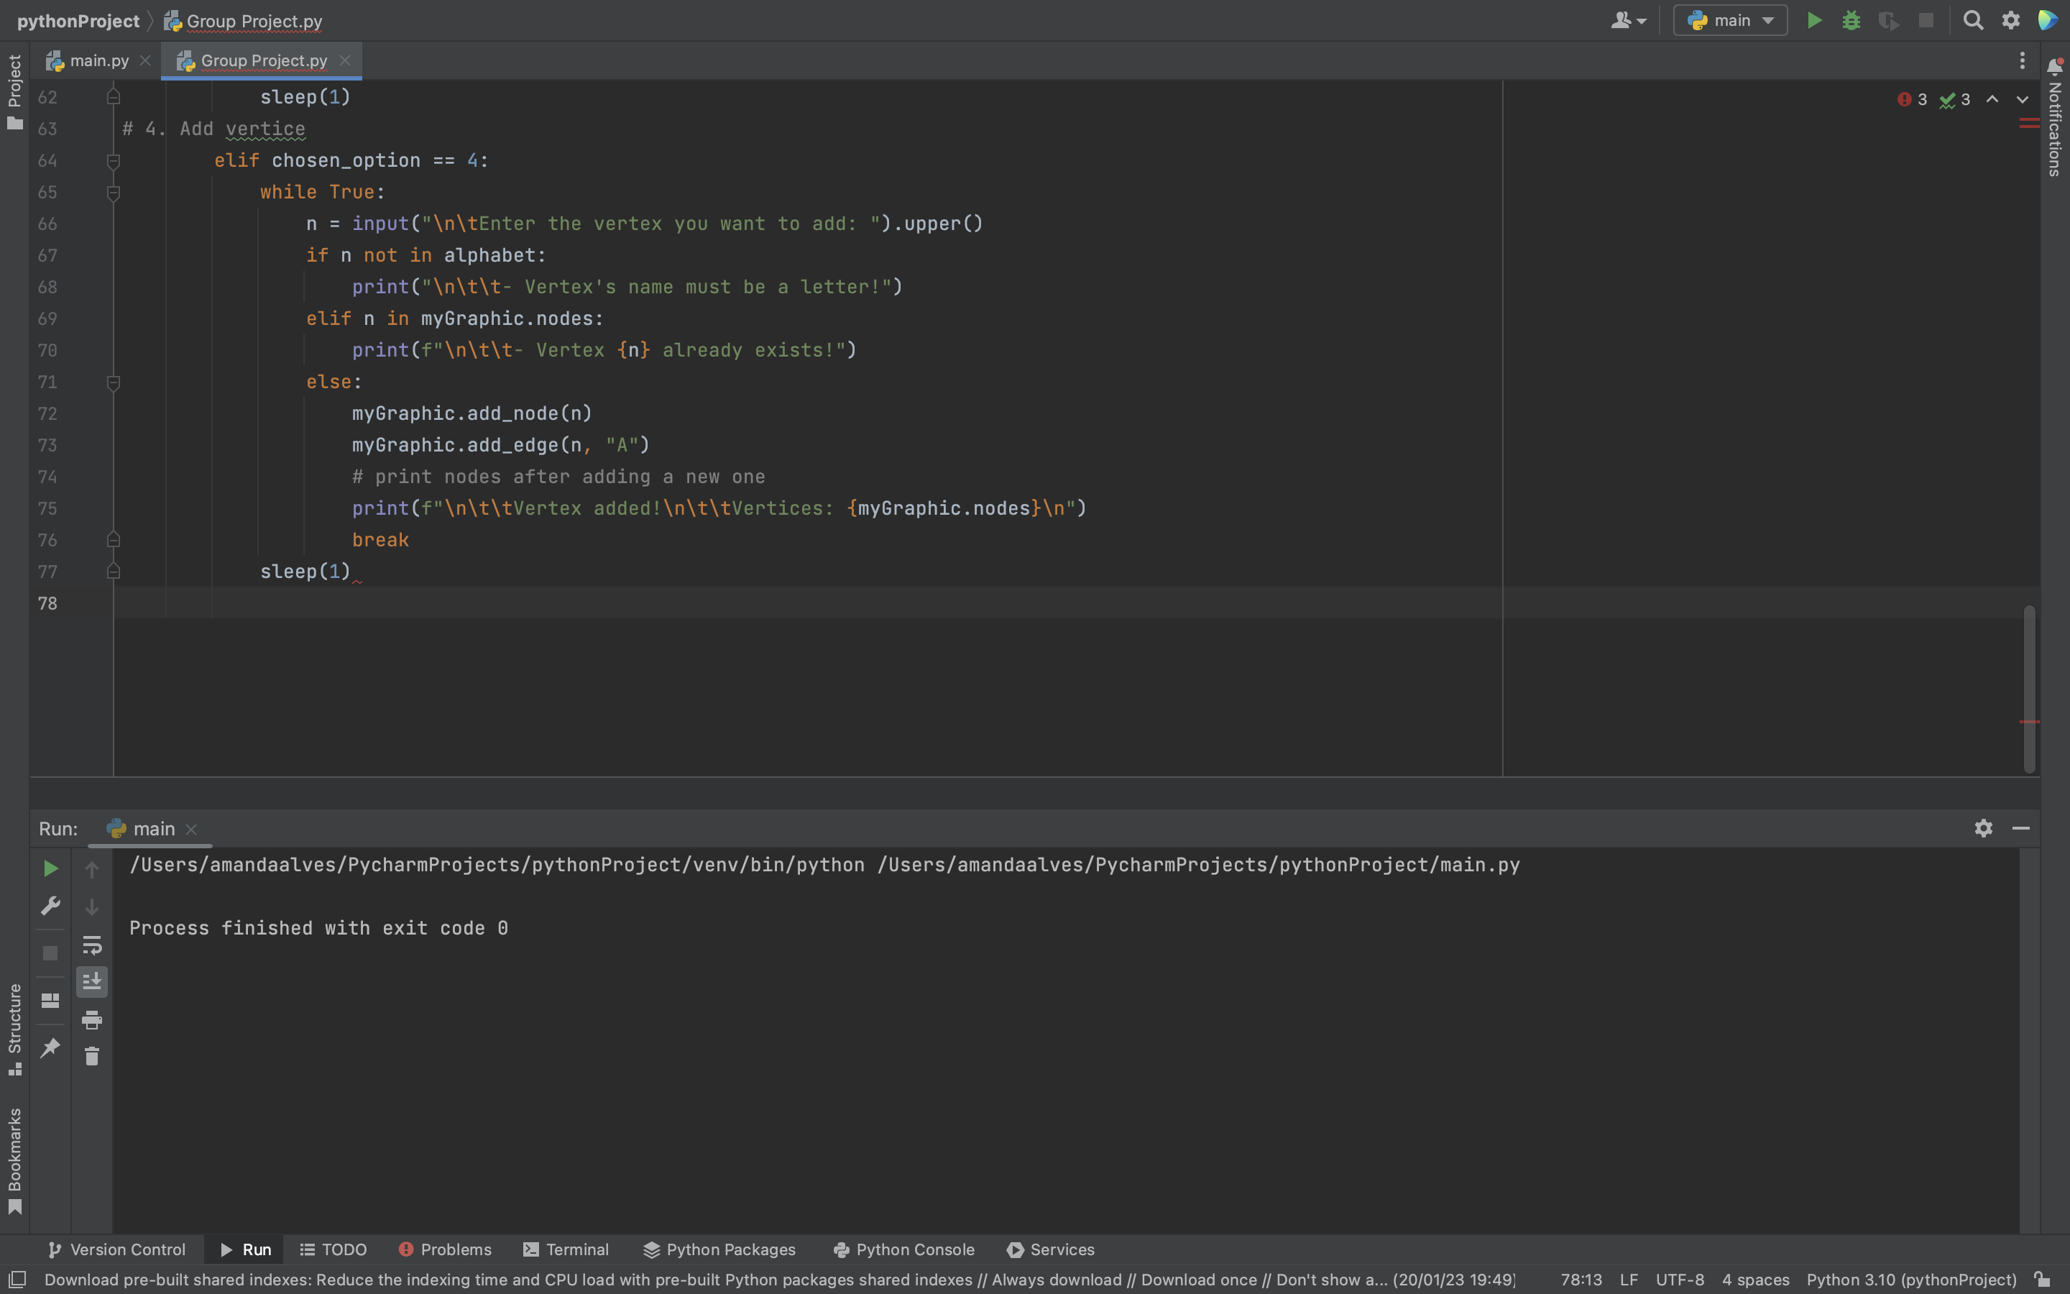
Add a Vertex
Add a new vertex to the graph and connect it with all other vértices.

Slide 13
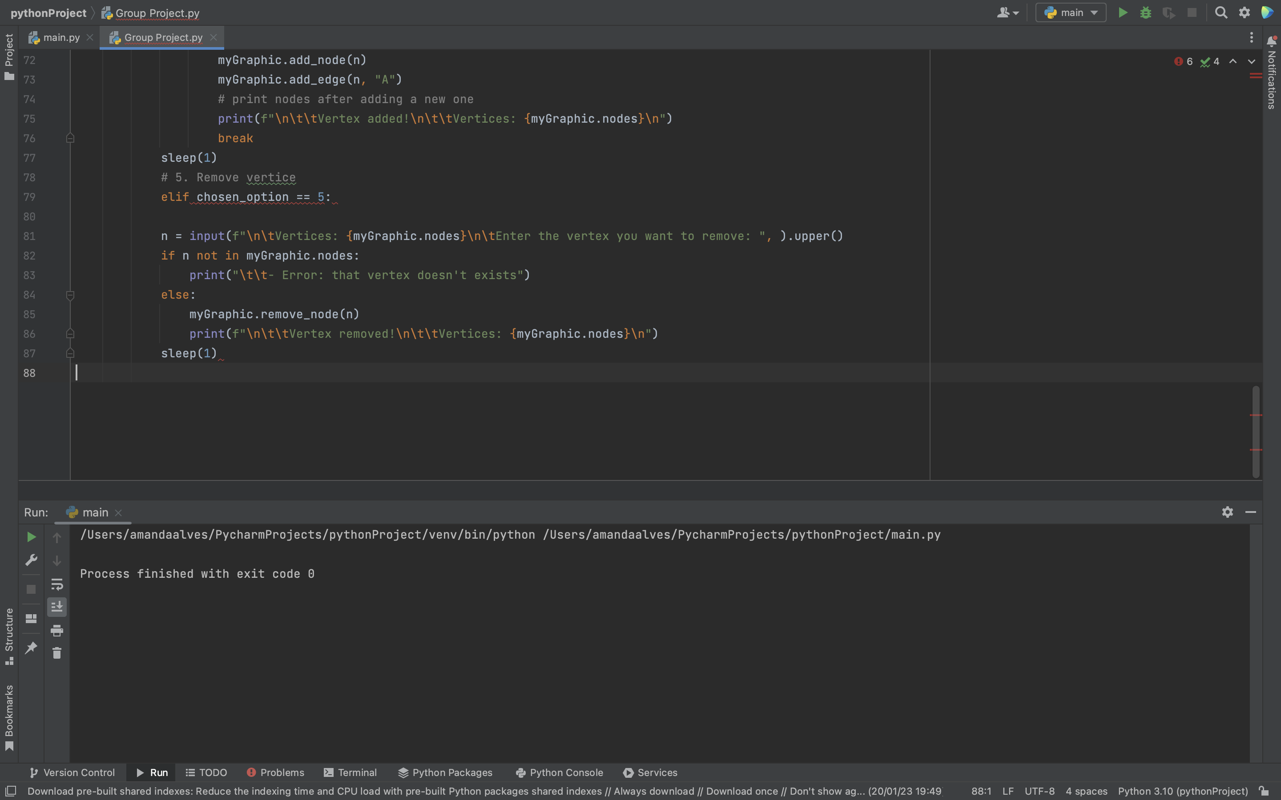
Delete a Vertex
Delete a vertex from the graph.

Slide 14
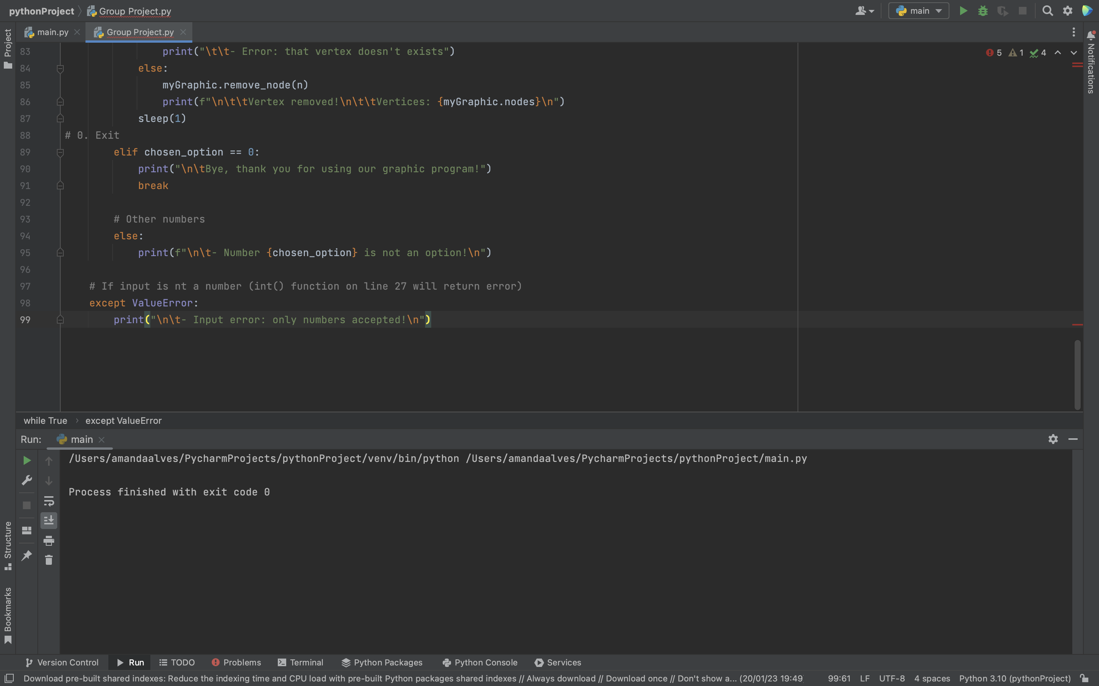
Exit and other numbers

Slide 15
OUTPUTS
TIME

Slide 16

THANK YOU!

